Slide 1
Data Science
Unit-III
Multidimensional Scaling
Source: Web resources

Slide 2
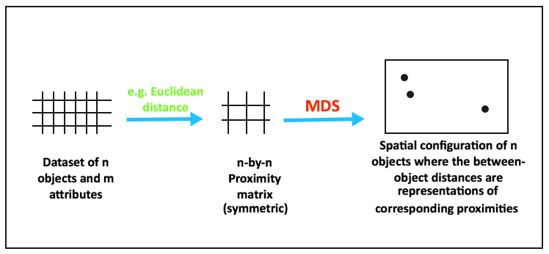
Introduction
Dimensionality Reduction: PCA, Linear Discriminant Analysis(LDA).
Multidimensional scaling (MDS) is a technique that creates a map displaying the relative positions of several objects, given only a table of the distances between them.
The map may consist of one, two, three, or even more dimensions.
The program calculates either the metric or the non-metric solution.
The table of distances is known as the proximity matrix. It arises either directly from experiments or indirectly as a correlation matrix.

Slide 3
Multidimensional Scaling (MDS)
It is Supervised learning Dimensionality reduction.
Used for Non-linear type data, Many-fold data
It reduces n-dimensionality to lower dimensionality while preserving distances b/w samples.
MDS uses similarity or dissimilarity measure( Euclidian distance)
In this case two Methods can used
1. MDS
2. Isomaps

Slide 4
Procedure for Multidimensional Scaling
Formulate the Problem
Obtain Input Data
Select an MDS Procedure( Calculate Proximity matrix with similarity or dissimilarity values with Euclidian Distance )
Decide on the Number of Dimensions (generate New dimensions(lower) with 1. Eigen Decomposition method, 2. Optimizer method
Label the Dimensions and Interpret
the Configuration

Slide 5
1. Formulate the Problem
Specify the purpose of MDS.
Select the brands to be included in the analysis. Usually varies between 8 and 25 brands.
The choice of number and specific brands should be based on the marketing research problem, theory, and the judgment of the researcher.

Slide 6
2. Input Data for Multidimensional Scaling
MDS Input Data
Perceptions
Preferences
Direct (Similarity Judgments)
Derived (Attribute Ratings)

Slide 7
Direct Approach: Advantages and disadvantages
The direct approach has the following advantages and disadvantages:
1.The researcher does not have to identify a set of salient attributes.
2. The disadvantages are that the criteria are influenced by the brands or stimuli being evaluated.
3. Furthermore, it may be difficult to label the dimensions of the spatial map.

Slide 8
Derived Approach: Advantages and disadvantages
The attribute-based approach has the following advantages and disadvantages:
1. It is easier to label the dimensions.
2. A disadvantage is that the researcher must identify all the salient attributes, a difficult task.
Use both these approaches. Direct similarity judgments used for obtaining the spatial map, and attribute ratings used to interpret dimensions of the perceptual map.

Slide 9
3. Select an MDS Procedure: Types of MDS
Whether perception or preference data are being scaled, or whether the analysis requires both kinds of data.
The nature of the input data is also a determining factor.
Non-metric MDS procedures assume that the input data are ordinal, but they result in metric output.
Metric MDS methods assume that input data are metric (Interval scaled, Ratio scaled attributes). Since the output is also metric, a stronger relationship between the output and input data exists.
Classical MDS: Also known as Principal Coordinates Analysis (PCoA), it uses eigenvalue decomposition of the distance matrix.
( One matrix), Weighted MDS (several Matrices used)
The metric and non-metric methods produce similar results.
Another factor influencing the selection of a procedure is whether the MDS analysis will be conducted at the individual respondent level or at an aggregate level.

Slide 10
4. Identify the Number of Dimensions
To generate new lower dimension , we can use two methods: a. Eigen Decomposition: Calculate eigen vector for Proximity matrix. Calculate new lower dimension with multiply Eigen vector with original data.
b. Optimizer method: Use Stress function calculate goodness-fit
In stress function: It calculate predicted and actual distances- it should be minimize the difference
A priori knowledge - Theory or past research
Interpretability of the spatial map - Difficult to interpret in more than three dimensions.
Elbow criterion - A plot of stress versus dimensionality.
Statistical approaches - Statistical approaches are also available for determining the dimensionality.

Slide 11
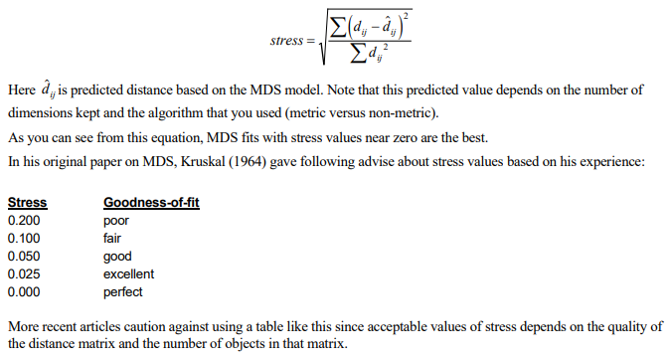
Identify the Number of Dimensions: b. Optimizer method: Stress function Goodness-of-fit
In the case of MDS, you are trying to model the distances. Hence, the most obvious choice for a goodness-of-fit statistic is one based on the differences between the actual distances and their predicted values. Such a measure is called stress and is calculated as values

Slide 12
Identify the Number of Dimensions:
One of the goals of the MDS analysis is to keep the number of dimensions as small as possible.
Usually, the analyst will anticipate select two or, at most, three dimensions.
If more are required, you may decide that MDS is not appropriate for your data
The usual technique is to solve the MDS problem for a number of dimension values and adopt the smallest number of dimensions that achieves a reasonably small value of stress.
The program displays a simple bar chart of the stress values to aid in the selection of the number of dimensions

Slide 13
5. Label and Interpret Dimensions
Even with direct similarity judgments, ratings of the brands on attributes may still be collected. These attribute vectors may be fitted in the spatial map.
Respondents may be asked to indicate the criteria they used in making their evaluations.
If objective characteristics of the brands are available these could be used to in interpreting the subjective dimensions of the spatial maps.

Slide 14
Assess Reliability and Validity
On the index of fit, or R-square values of 0.60 or better are considered acceptable.
Stress values measure badness-of-fit, or the proportion of variance of data that is not accounted for by the MDS model. Stress values of less than 10% are considered acceptable.

Slide 15
Assumptions and Limitations of MDS
Objects should be comparable: It is assumed that the similarity of stimulus A to B is the same as the similarity of stimulus B to A.
MDS assumes that the distance (similarity) between two stimuli is some function of their partial similarities on each of several perceptual dimensions.
Representativeness of the objects: The mapping should cover all most 70% market share will be covered.
When a spatial map is obtained, it is assumed that interpoint distances are ratio scaled and that the axes of the map are multidimensional interval scaled.
A limitation of MDS is that dimension interpretation relating physical changes in brands or stimuli to changes in the perceptual map is difficult at best.

Slide 16
Applications of the MDS
Image measurement
Brand positioning
market segmentation
New product development
Assessing Adverting effectiveness
Pricing Analysis
Channel Decisions

Slide 17
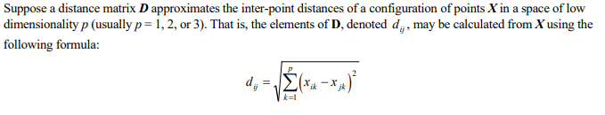
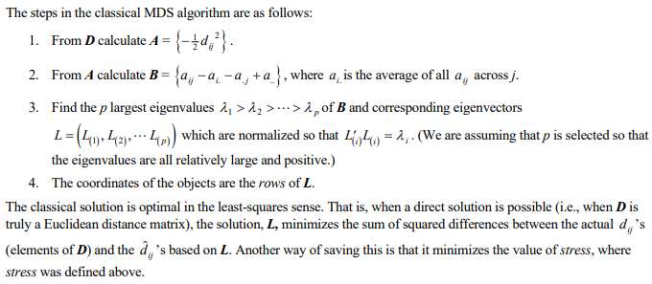
The steps in the classical MDS algorithm:

Slide 18
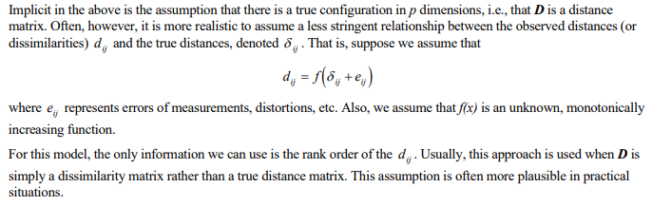
Non- Metric MDS:

Slide 19
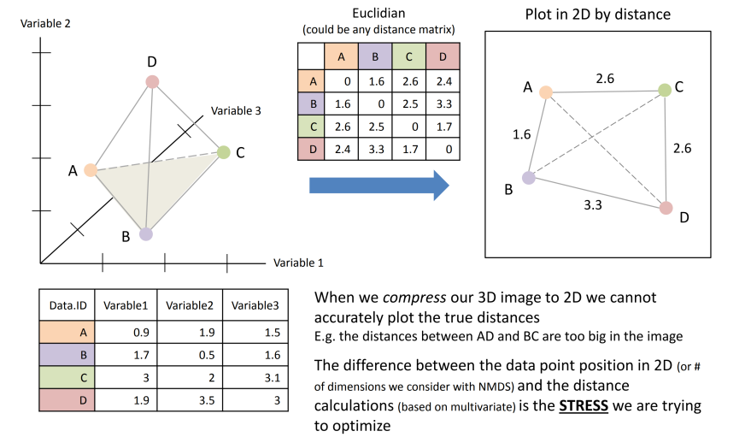
Example:

Slide 20
MDS: Case study Perceptual mapping of Toothpaste
Perception Data: Direct Approaches: respondents are asked to judge how similar or dissimilar the various brands are. These data are referred to as similarity judgments.
Consider similarity ratings of various toothpaste brands:
Very Very
Dissimilar Similar
Crest vs. Colgate 1 2 3 4 5 6 7
Aqua-Fresh vs. Crest 1 2 3 4 5 6 7
Crest vs. Aim 1 2 3 4 5 6 7
.
.
.
Colgate vs. Aqua-Fresh 1 2 3 4 5 6 7
The number of pairs to be evaluated is n (n -1)/2, where n is the number of stimuli.

Slide 21
Case study: Similarity Rating Of Toothpaste Brands

Slide 22
Case study: Input Data
Perception Data: Derived Approaches: Attribute-based approaches requiring the respondents to rate the brands on the identified attributes using semantic differential or Likert scales.
Whitens Does not
teeth ___ ___ ___ ___ ___ ___ ___ ___ ___ ___ whiten teeth
Prevents tooth Does not prevent
decay ___ ___ ___ ___ ___ ___ ___ ___ ___ ___ tooth decay
.
.
.
Pleasant Unpleasant
tasting ___ ___ ___ ___ ___ ___ ___ ___ ___ ___ tasting
If attribute ratings are obtained, a similarity measure (such as Euclidean distance) is derived for each pair of brands.

Slide 23
Plot of Stress Versus Dimensionality
0.3
0.2
Stress
0.1
0.0
0
1
2
3
4
5
Number of Dimensions

Slide 24
A Spatial Map of Toothpaste Brands
2.0
1.5
1.0
Plus White
Aim
0.5
Ultrabrite
Gleem
Crest
Pepsodent
0.0
Colgate
-0.5
Close Up
Aqua- Fresh
-1.0
Sensodyne
-1.5
-2.0
-2.0
-1.5
-1.0
-0.5
0.0
0.5
1.0
1.5
2.0

Slide 25
Using Attributes to Label Dimensions
2.0
1.5
1.0
Plus White
Aim
0.5
Ultrabrite
Gleem
Crest
Fights Cavities
Pepsodent
0.0
Close Up
Colgate
-0.5
Aqua- Fresh
Whitens Teeth
-1.0
Sensodyne
-1.5
Sensitivity Protection
-2.0
-2.0
-1.5
-1.0
-0.5
0.0
0.5
1.0
1.5
2.0

Slide 26
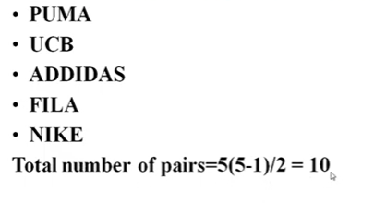
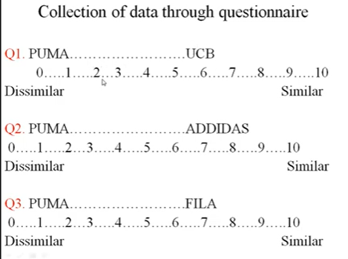

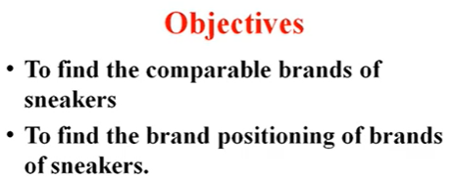
MDS: Case study Perceptual mapping of Sneakers (one matrix)

Slide 27
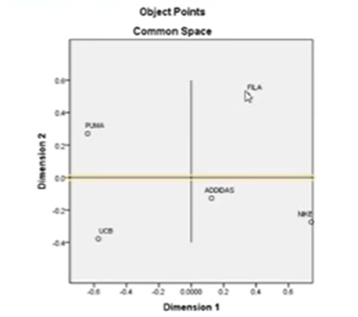
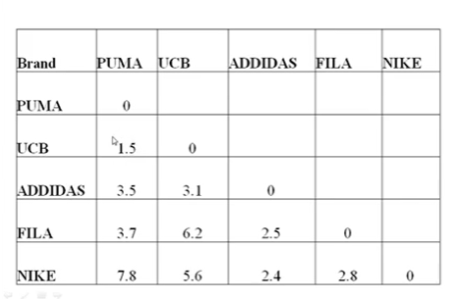
Case study

Slide 28
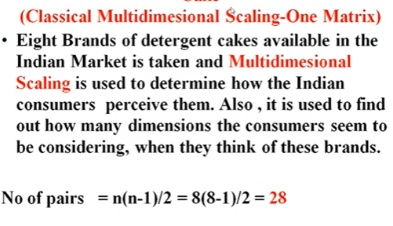
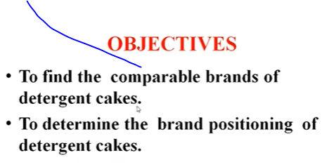
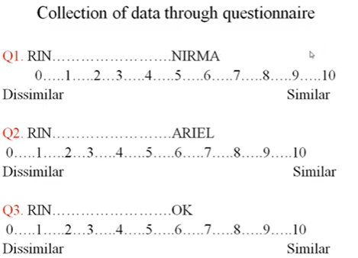
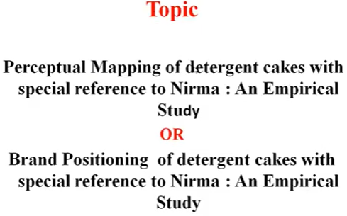
MDS: Case study: Detergent cakes

Slide 29
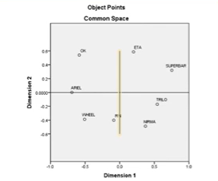
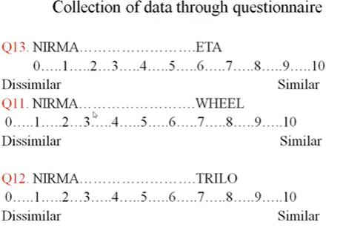
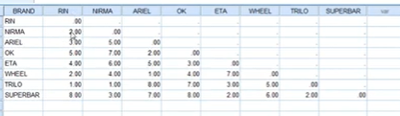
Case study: perceptual space

Slide 30
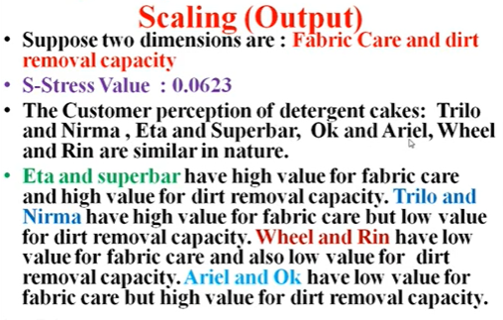
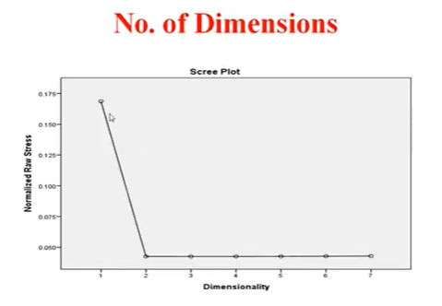
Case study

Slide 31
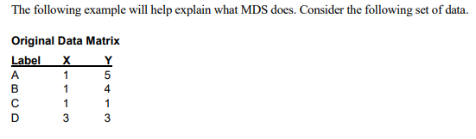
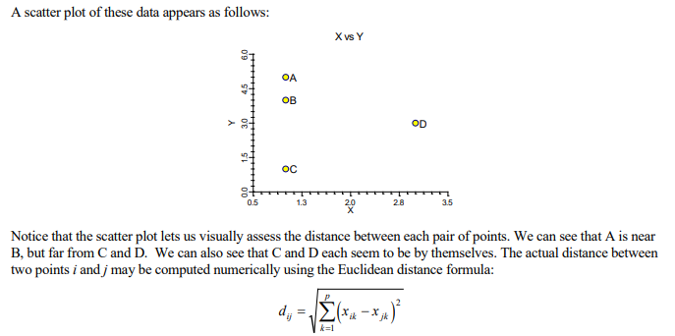
Multi Dimensional Scaling: Example

Slide 32
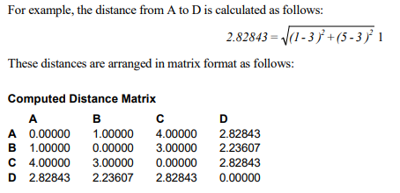
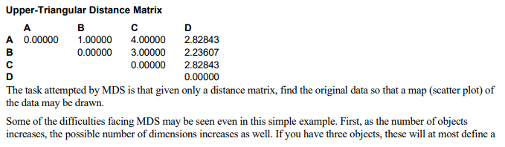
Example for MDS

Slide 33
Difficulties facing MDS
Some of the difficulties facing MDS may be seen even in this simple example.
First, as the number of objects increases, the possible number of dimensions increases as well. If you have three objects, these will at most define a two-dimensional plane. With four objects, you will usually find a three-dimensional space. And so on, with each new object adding one more possible dimension.
Notice that if the data are shifted in such a way that their positions relative to each other are maintained (rotated, translated, or transposed), the computed distance matrix will be the same. Hence, the distance matrix could have come from numerous sets of data.
When the distances themselves are not actually known. You might only be given knowledge of their relative size

